Slide 1
Data Mining: Exploring Data
Lecture Notes for Chapter 3
Introduction to Data Mining
by
Tan, Steinbach, Kumar

Slide 2
What is data exploration?
A preliminary exploration of the data to better understand its characteristics.
Key motivations of data exploration include
  Helping to select the right tool for preprocessing or analysis
  Making use of humans’ abilities to recognize patterns
    People can recognize patterns not captured by data analysis tools
Related to the area of Exploratory Data Analysis (EDA)
  Created by statistician John Tukey
  Seminal book is Exploratory Data Analysis by Tukey
  A nice online introduction can be found in Chapter 1 of the NIST Engineering Statistics Handbook
  http://www.itl.nist.gov/div898/handbook/index.htm

Slide 3
Techniques Used In Data Exploration
In EDA, as originally defined by Tukey
  The focus was on visualization
  Clustering and anomaly detection were viewed as exploratory techniques
  In data mining, clustering and anomaly detection are major areas of interest, and not thought of as just exploratory
In our discussion of data exploration, we focus on
  Summary statistics
  Visualization
  Online Analytical Processing (OLAP)

Slide 4
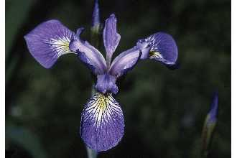
Iris Sample Data Set
Many of the exploratory data techniques are illustrated with the Iris Plant data set.
  Can be obtained from the UCI Machine Learning Repository
  http://www.ics.uci.edu/~mlearn/MLRepository.html
  From the statistician Douglas Fisher
  Three flower types (classes):
    Setosa
    Virginica
    Versicolour
  Four (non-class) attributes
    Sepal width and length
    Petal width and length
Virginica. Robert H. Mohlenbrock. USDA NRCS. 1995. Northeast wetland flora: Field office guide to plant species. Northeast National Technical Center, Chester, PA. Courtesy of USDA NRCS Wetland Science Institute.

Slide 5
Summary Statistics
Summary statistics are numbers that summarize properties of the data
  Summarized properties include frequency, location and spread
    Examples: location - mean
    spread - standard deviation
  Most summary statistics can be calculated in a single pass through the data

Slide 6
Frequency and Mode
The frequency of an attribute value is the percentage of time the value occurs in the
data set
  For example, given the attribute ‘gender’ and a representative population of people, the gender ‘female’ occurs about 50% of the time.
The mode of a an attribute is the most frequent attribute value
The notions of frequency and mode are typically used with categorical data

Slide 7
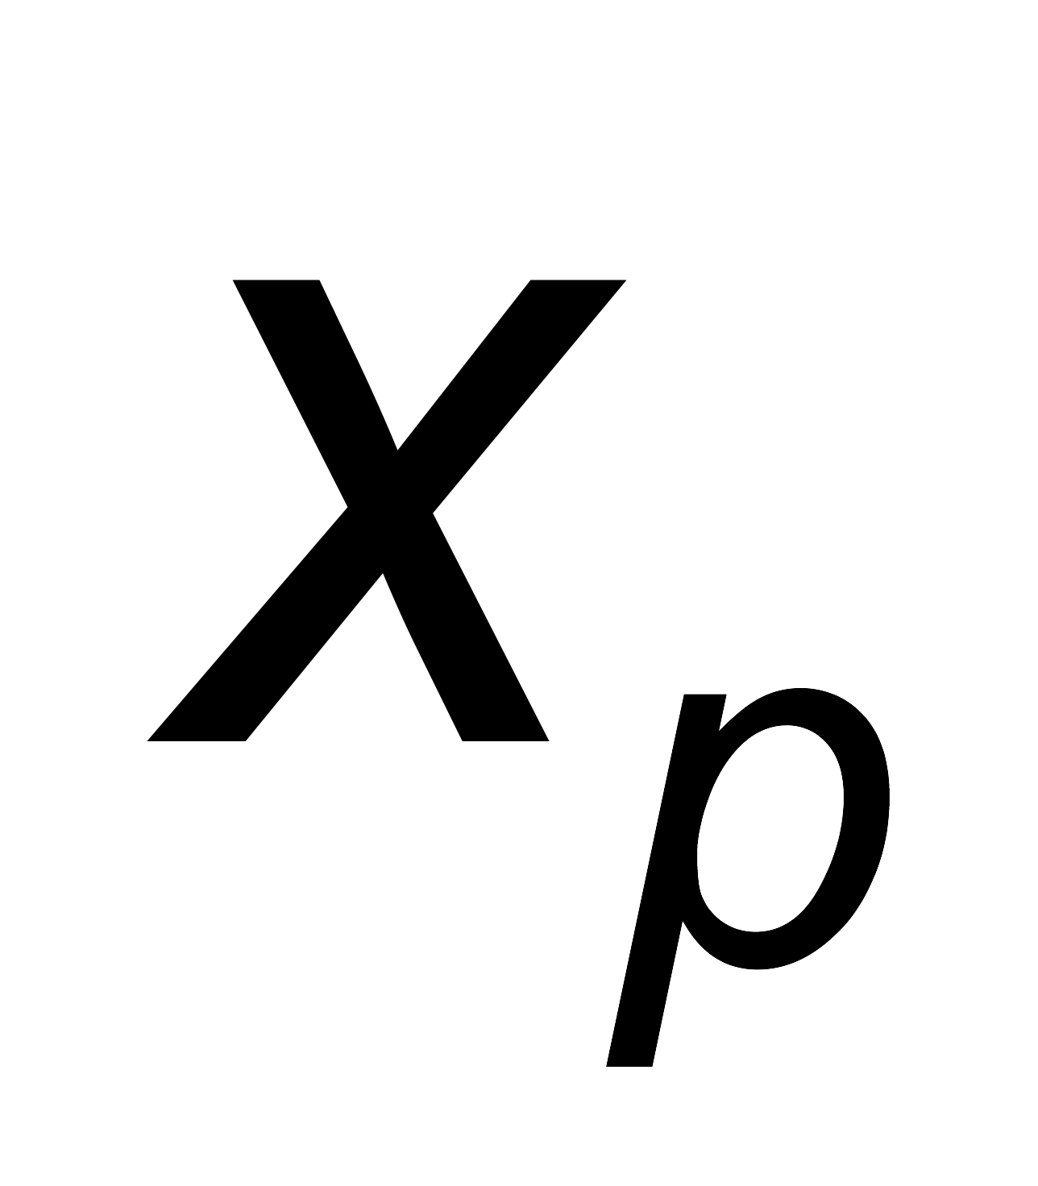
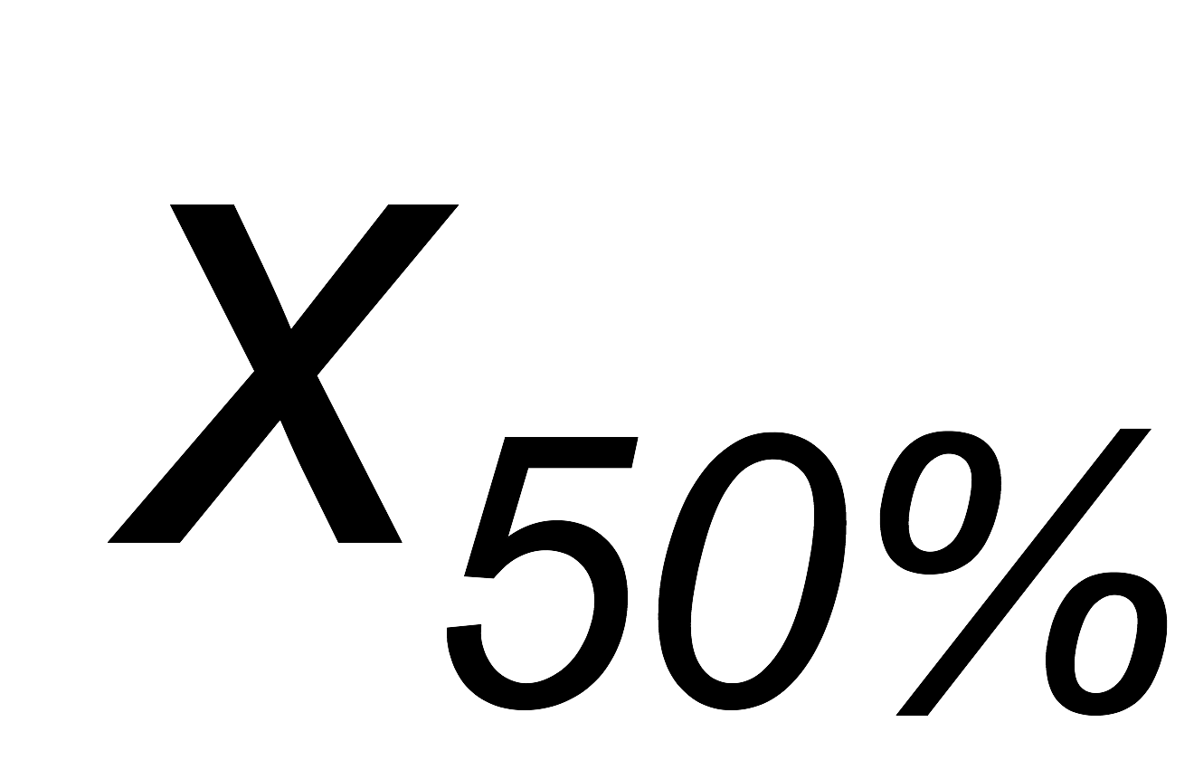
Percentiles
For continuous data, the notion of a percentile is more useful.
Given an ordinal or continuous attribute x and a number p between 0 and 100, the pth percentile is a value of x such that p% of the observed values of x are less than .
For instance, the 50th percentile is the value such that 50% of all values of x are less than .

Slide 8
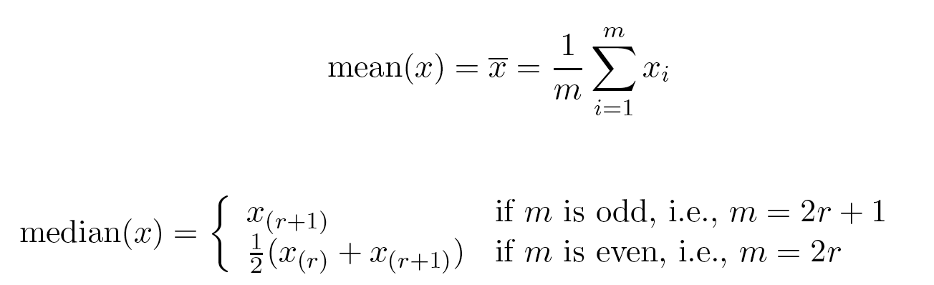
Measures of Location: Mean and Median
The mean is the most common measure of the location of a set of points.
However, the mean is very sensitive to outliers.
Thus, the median or a trimmed mean is also commonly used.

Slide 9
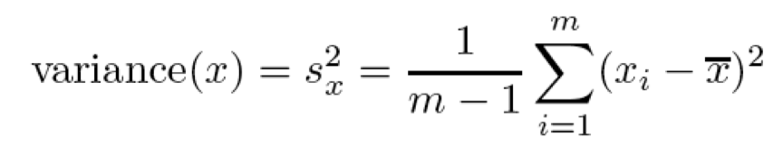
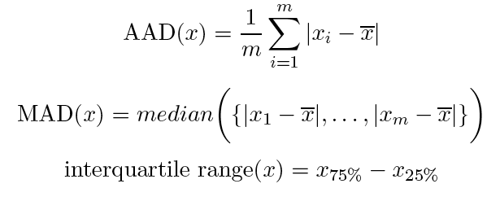
Measures of Spread: Range and Variance
Range is the difference between the max and min
The variance or standard deviation is the most common measure of the spread of a set of points.
However, this is also sensitive to outliers, so that other measures are often used.

Slide 10
Visualization
Visualization is the conversion of data into a visual or tabular format so that the characteristics of the data and the relationships among data items or attributes can be analyzed or reported.
Visualization of data is one of the most powerful and appealing techniques for data exploration.
  Humans have a well developed ability to analyze large amounts of information that is presented visually
  Can detect general patterns and trends
  Can detect outliers and unusual patterns

Slide 11
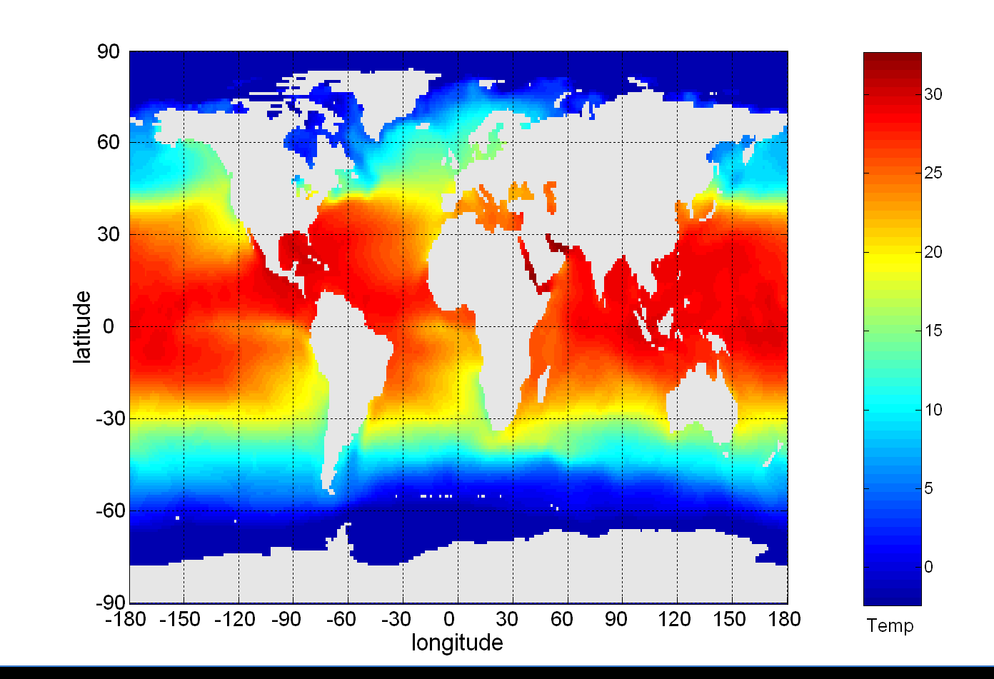
Example: Sea Surface Temperature
The following shows the Sea Surface Temperature (SST) for July 1982
  Tens of thousands of data points are summarized in a single figure

Slide 12
Representation
Is the mapping of information to a visual format
Data objects, their attributes, and the relationships among data objects are translated into graphical elements such as points, lines, shapes, and colors.
Example:
  Objects are often represented as points
  Their attribute values can be represented as the position of the points or the characteristics of the points, e.g., color, size, and shape
  If position is used, then the relationships of points, i.e., whether they form groups or a point is an outlier, is easily perceived.

Slide 13
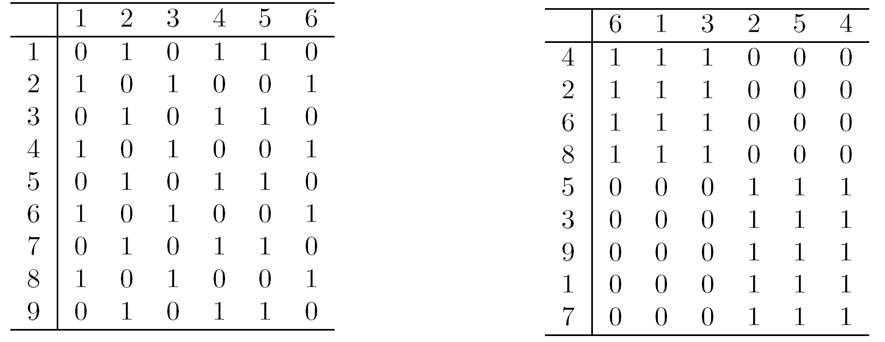
Arrangement
Is the placement of visual elements within a display
Can make a large difference in how easy it is to understand the data
Example:

Slide 14
Selection
Is the elimination or the de-emphasis of certain objects and attributes
Selection may involve the chossing a subset of attributes
  Dimensionality reduction is often used to reduce the number of dimensions to two or three
  Alternatively, pairs of attributes can be considered
Selection may also involve choosing a subset of objects
  A region of the screen can only show so many points
  Can sample, but want to preserve points in sparse areas

Slide 15
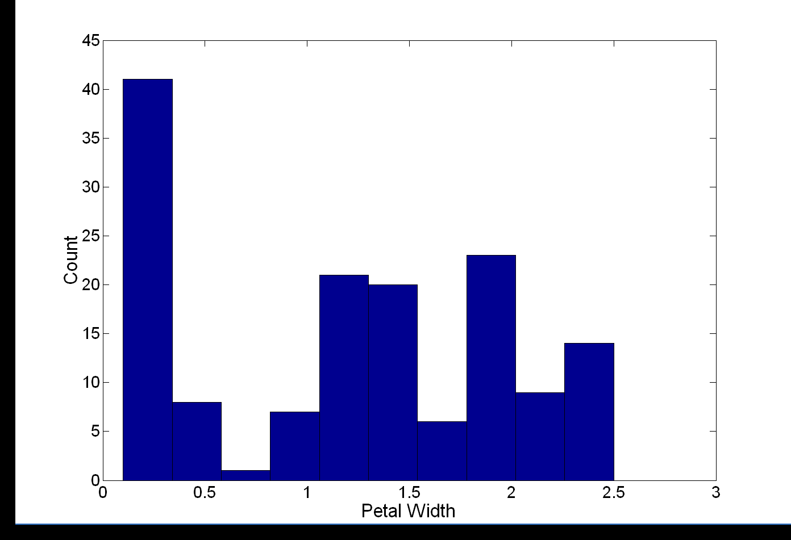
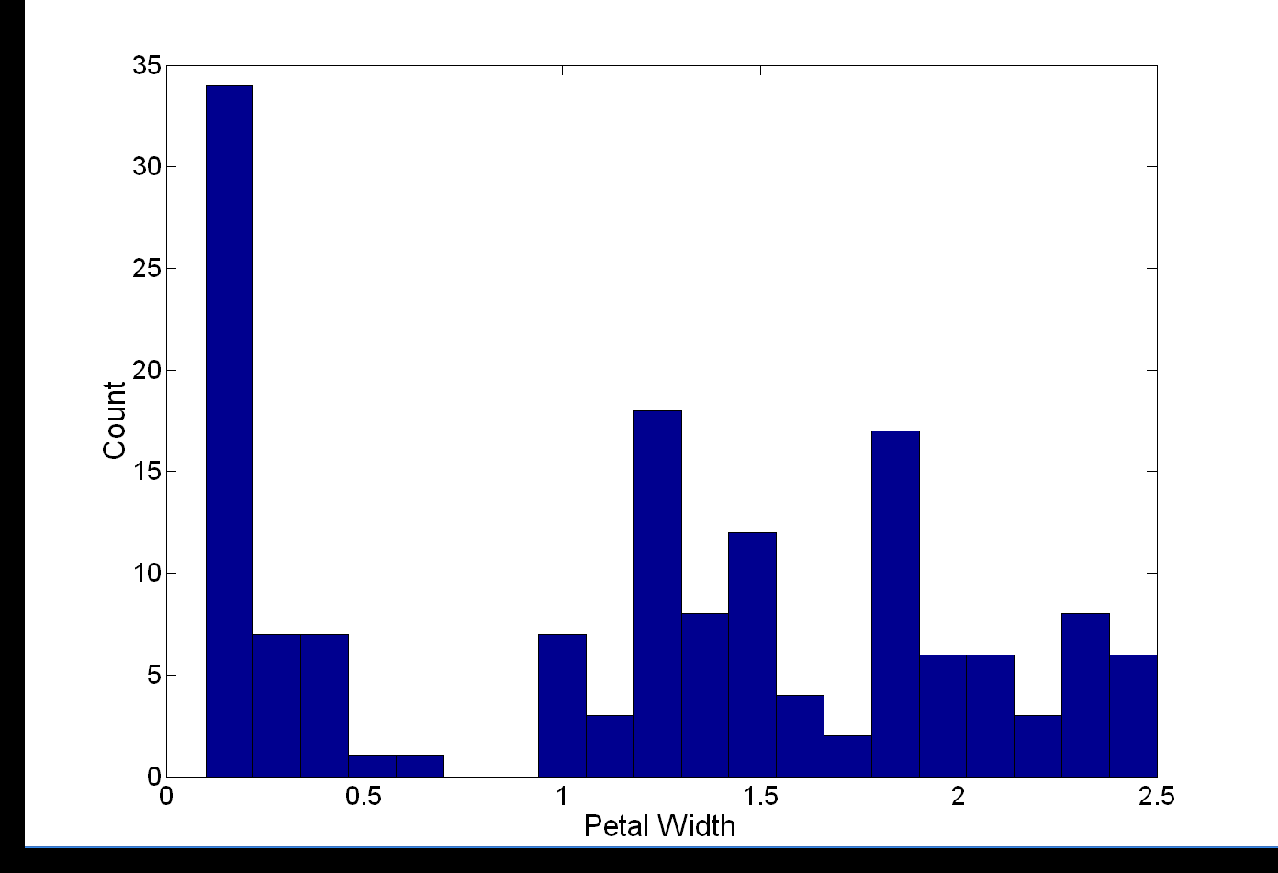
Visualization Techniques: Histograms
Histogram
  Usually shows the distribution of values of a single variable
  Divide the values into bins and show a bar plot of the number of objects in each bin.
  The height of each bar indicates the number of objects
  Shape of histogram depends on the number of bins
Example: Petal Width (10 and 20 bins, respectively)

Slide 16
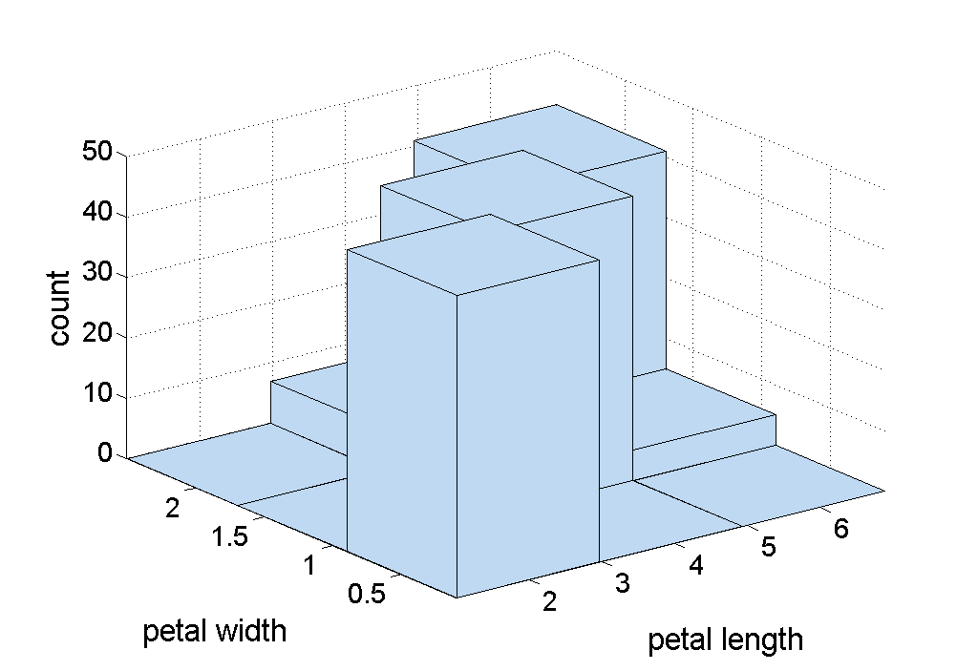
Two-Dimensional Histograms
Show the joint distribution of the values of two attributes
Example: petal width and petal length
  What does this tell us?

Slide 17
Visualization Techniques: Box Plots
Box Plots
  Invented by J. Tukey
  Another way of displaying the distribution of data
  Following figure shows the basic part of a box plot
outlier
10th percentile
75th percentile
50th percentile
25th percentile
10th percentile

Slide 18
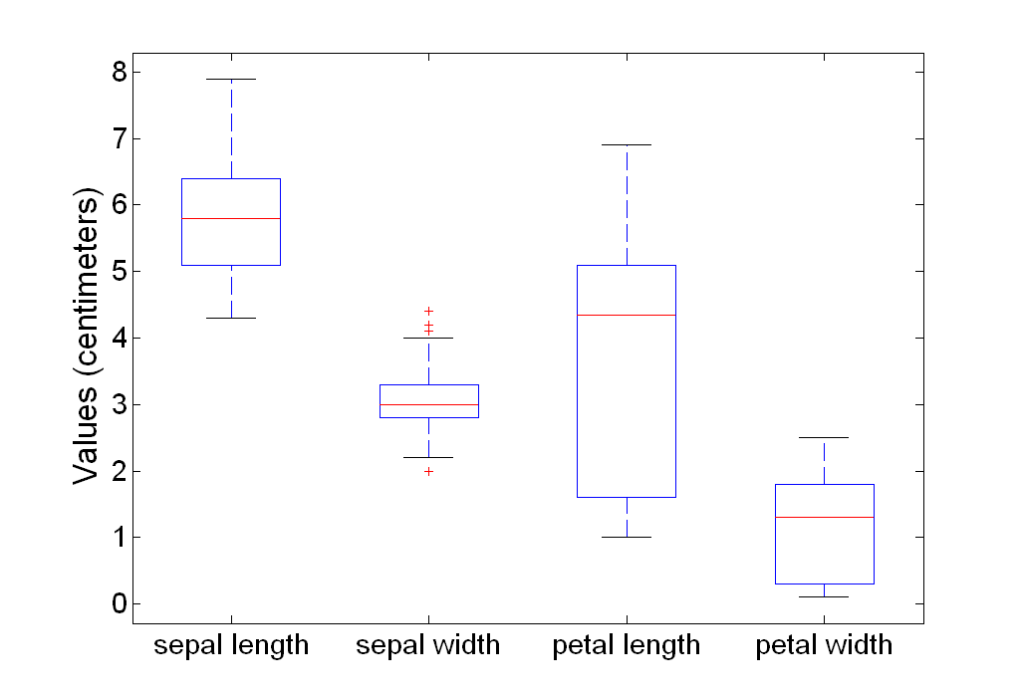
Example of Box Plots
Box plots can be used to compare attributes

Slide 19
Visualization Techniques: Scatter Plots
Scatter plots
  Attributes values determine the position
  Two-dimensional scatter plots most common, but can have three-dimensional scatter plots
  Often additional attributes can be displayed by using the size, shape, and color of the markers that represent the objects
  It is useful to have arrays of scatter plots can compactly summarize the relationships of several pairs of attributes
    See example on the next slide

Slide 20
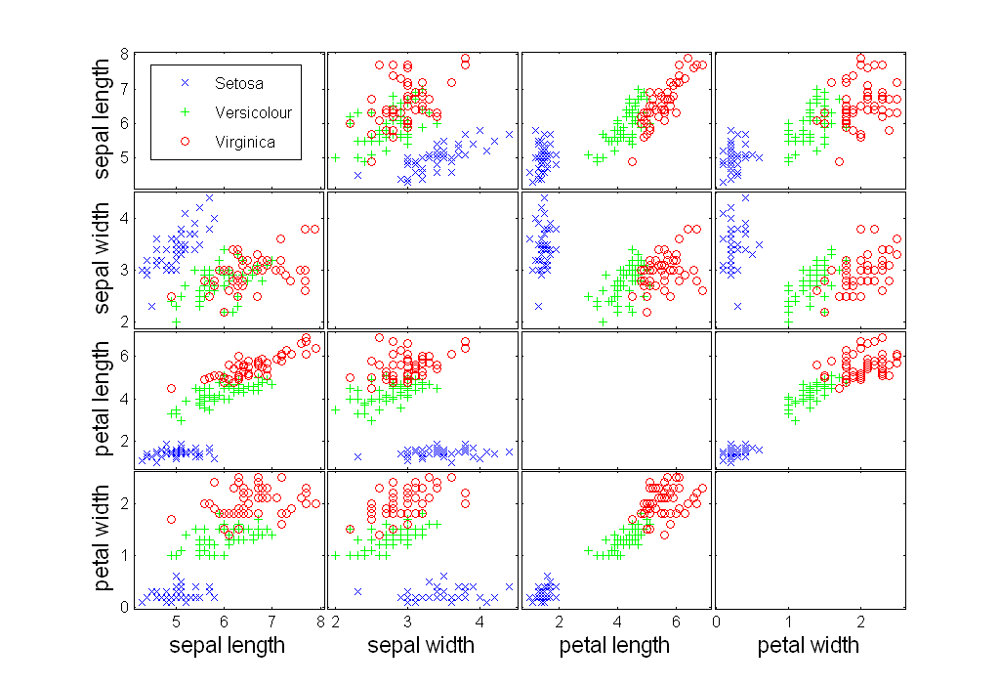
Scatter Plot Array of Iris Attributes

Slide 21
Visualization Techniques: Contour Plots
Contour plots
  Useful when a continuous attribute is measured on a spatial grid
  They partition the plane into regions of similar values
  The contour lines that form the boundaries of these regions connect points with equal values
  The most common example is contour maps of elevation
  Can also display temperature, rainfall, air pressure, etc.
    An example for Sea Surface Temperature (SST) is provided on the next slide

Slide 22
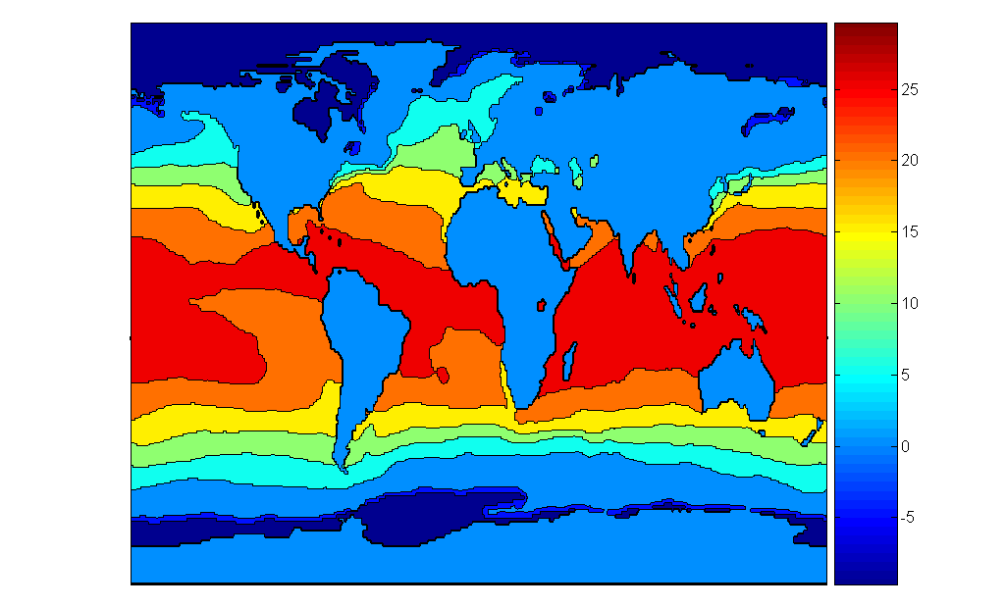
Contour Plot Example: SST Dec, 1998
Celsius

Slide 23
Visualization Techniques: Matrix Plots
Matrix plots
  Can plot the data matrix
  This can be useful when objects are sorted according to class
  Typically, the attributes are normalized to prevent one attribute from dominating the plot
  Plots of similarity or distance matrices can also be useful for visualizing the relationships between objects
  Examples of matrix plots are presented on the next two slides

Slide 24
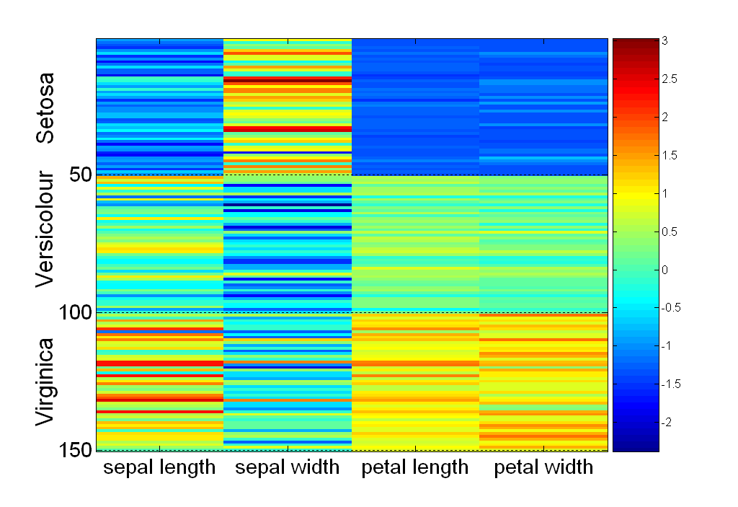
Visualization of the Iris Data Matrix
standard
deviation

Slide 25
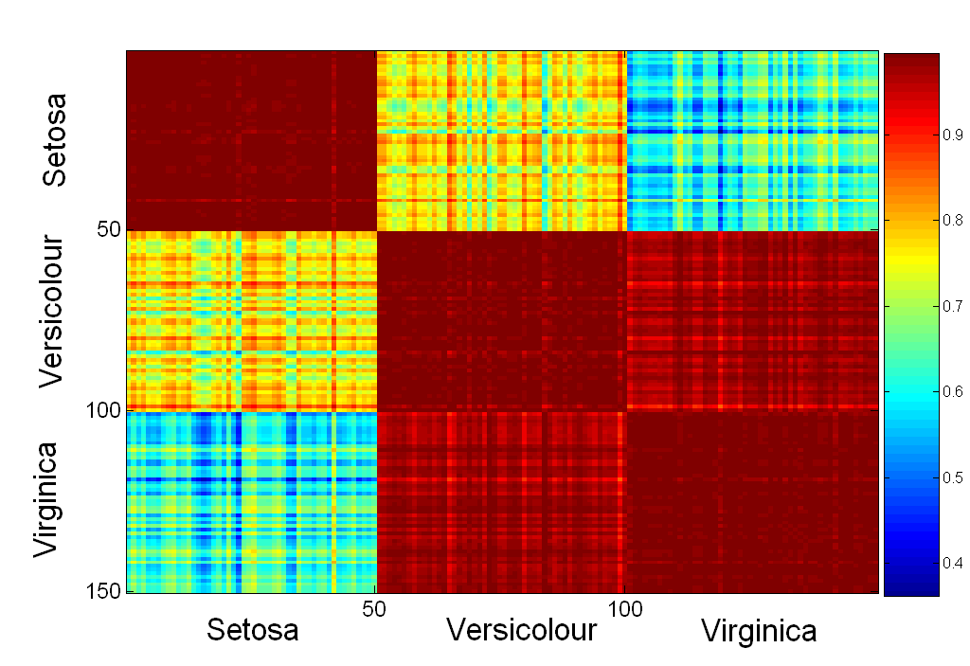
Visualization of the Iris Correlation Matrix

Slide 26
Visualization Techniques: Parallel Coordinates
Parallel Coordinates
  Used to plot the attribute values of high-dimensional data
  Instead of using perpendicular axes, use a set of parallel axes
  The attribute values of each object are plotted as a point on each corresponding coordinate axis and the points are connected by a line
  Thus, each object is represented as a line
  Often, the lines representing a distinct class of objects group together, at least for some attributes
  Ordering of attributes is important in seeing such groupings

Slide 27
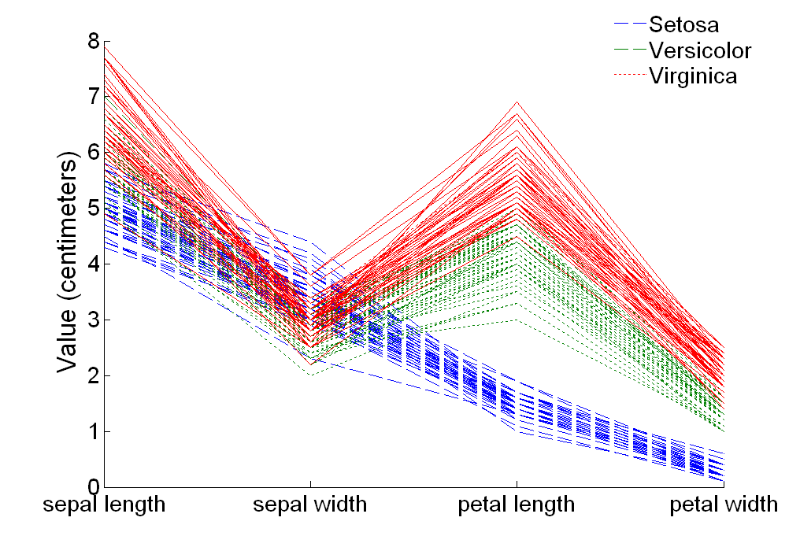
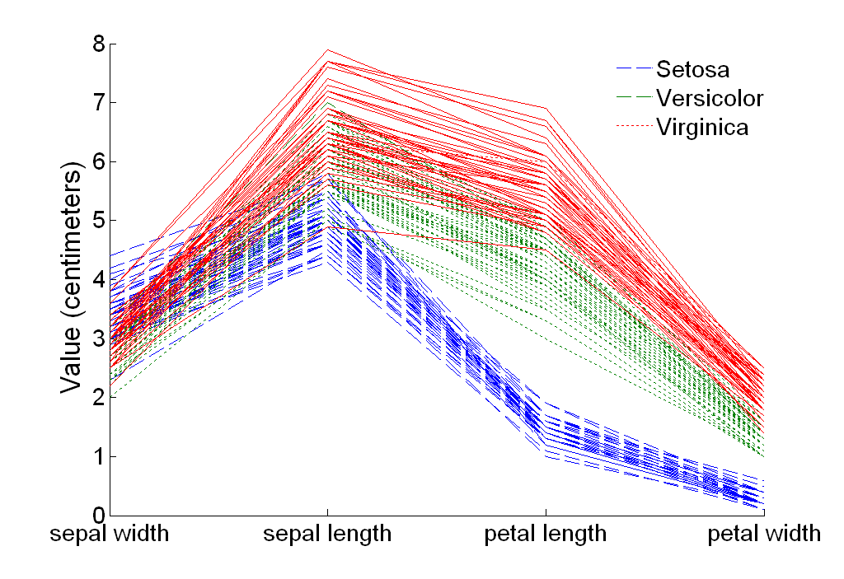
Parallel Coordinates Plots for Iris Data

Slide 28
Other Visualization Techniques
Star Plots
  Similar approach to parallel coordinates, but axes radiate from a central point
  The line connecting the values of an object is a polygon
Chernoff Faces
  Approach created by Herman Chernoff
  This approach associates each attribute with a characteristic of a face
  The values of each attribute determine the appearance of the corresponding facial characteristic
  Each object becomes a separate face
  Relies on human’s ability to distinguish faces

Slide 29
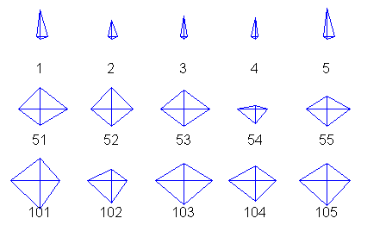
Star Plots for Iris Data
Setosa
Versicolour
Virginica

Slide 30
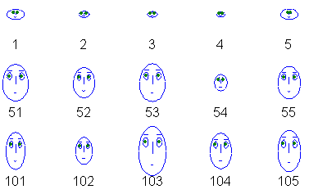
Chernoff Faces for Iris Data
Setosa
Versicolour
Virginica

Slide 31
OLAP
On-Line Analytical Processing (OLAP) was proposed by E. F. Codd, the father of the relational database.
Relational databases put data into tables, while OLAP uses a multidimensional array representation.
  Such representations of data previously existed in statistics and other fields
There are a number of data analysis and data exploration operations that are easier with such a data representation.

Slide 32
Creating a Multidimensional Array
Two key steps in converting tabular data into a multidimensional array.
  First, identify which attributes are to be the dimensions and which attribute is to be the target attribute whose values appear as entries in the multidimensional array.
    The attributes used as dimensions must have discrete values
    The target value is typically a count or continuous value, e.g., the cost of an item
    Can have no target variable at all except the count of objects that have the same set of attribute values
  Second, find the value of each entry in the multidimensional array by summing the values (of the target attribute) or count of all objects that have the attribute values corresponding to that entry.

Slide 33
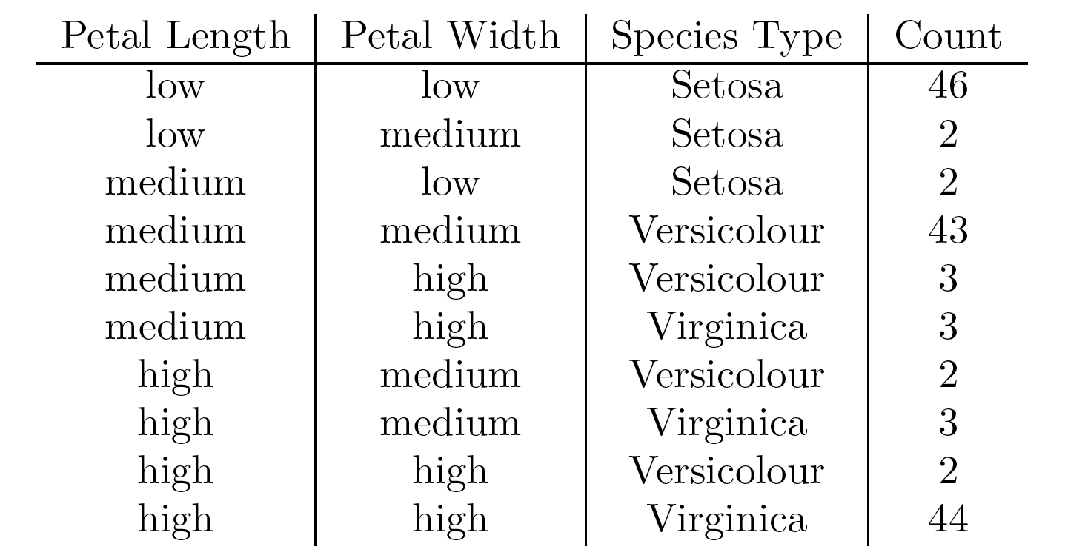
Example: Iris data
We show how the attributes, petal length, petal width, and species type can be converted to a multidimensional array
  First, we discretized the petal width and length to have categorical values: low, medium, and high
  We get the following table - note the count attribute

Slide 34
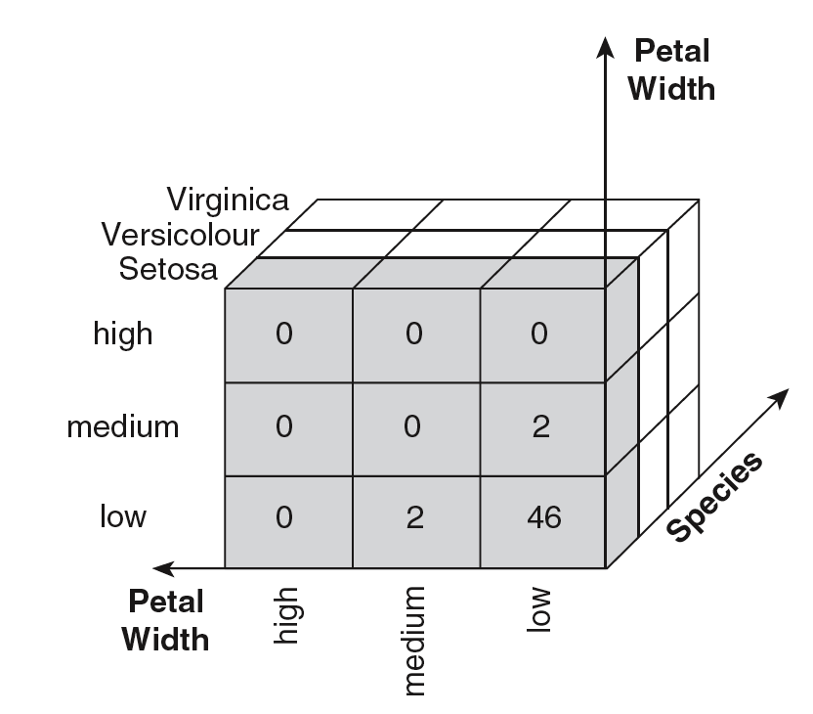
Example: Iris data (continued)
Each unique tuple of petal width, petal length, and species type identifies one element of the array.
This element is assigned the corresponding count value.
The figure illustrates
the result.
All non-specified
tuples are 0.

Slide 35
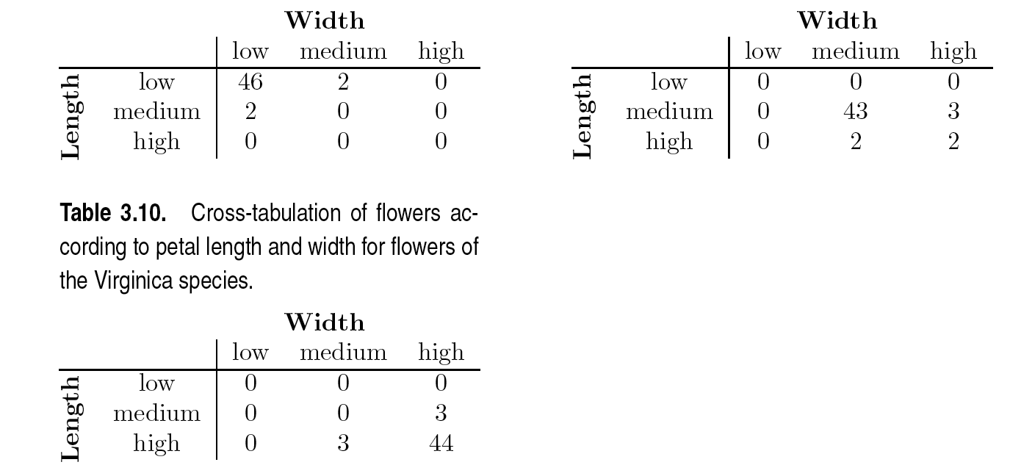
Example: Iris data (continued)
Slices of the multidimensional array are shown by the following cross-tabulations
What do these tables tell us?

Slide 36
OLAP Operations: Data Cube
The key operation of a OLAP is the formation of a data cube
A data cube is a multidimensional representation of data, together with all possible aggregates.
By all possible aggregates, we mean the aggregates that result by selecting a proper subset of the dimensions and summing over all remaining dimensions.
For example, if we choose the species type dimension of the Iris data and sum over all other dimensions, the result will be a one-dimensional entry with three entries, each of which gives the number of flowers of each type.

Slide 37
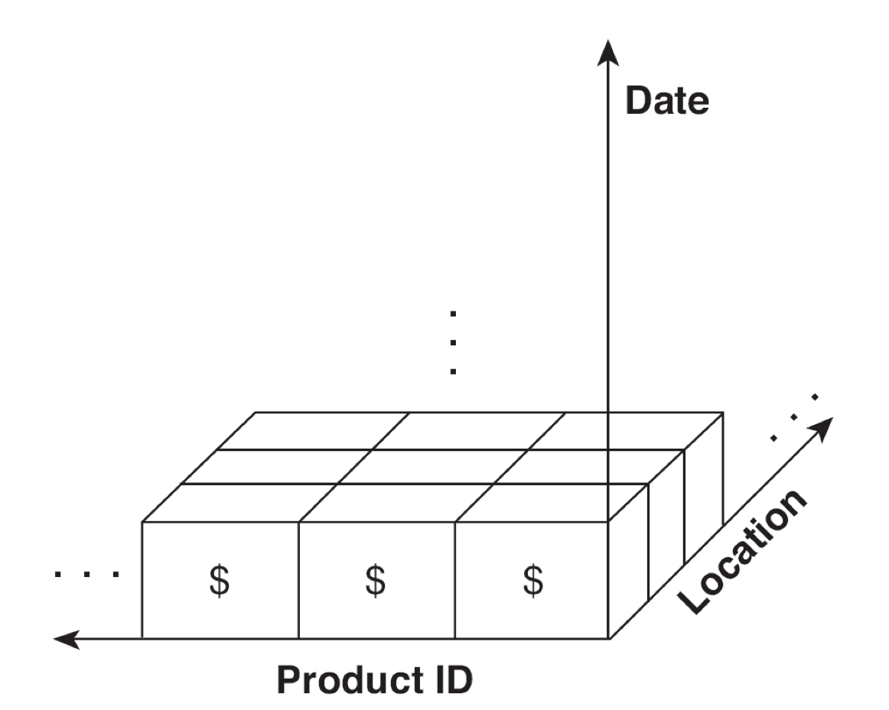
Data Cube Example
Consider a data set that records the sales of products at a number of company stores at various dates.
This data can be represented
as a 3 dimensional array
There are 3 two-dimensional
aggregates (3 choose 2 ),
3 one-dimensional aggregates,
and 1 zero-dimensional
aggregate (the overall total)

Slide 38
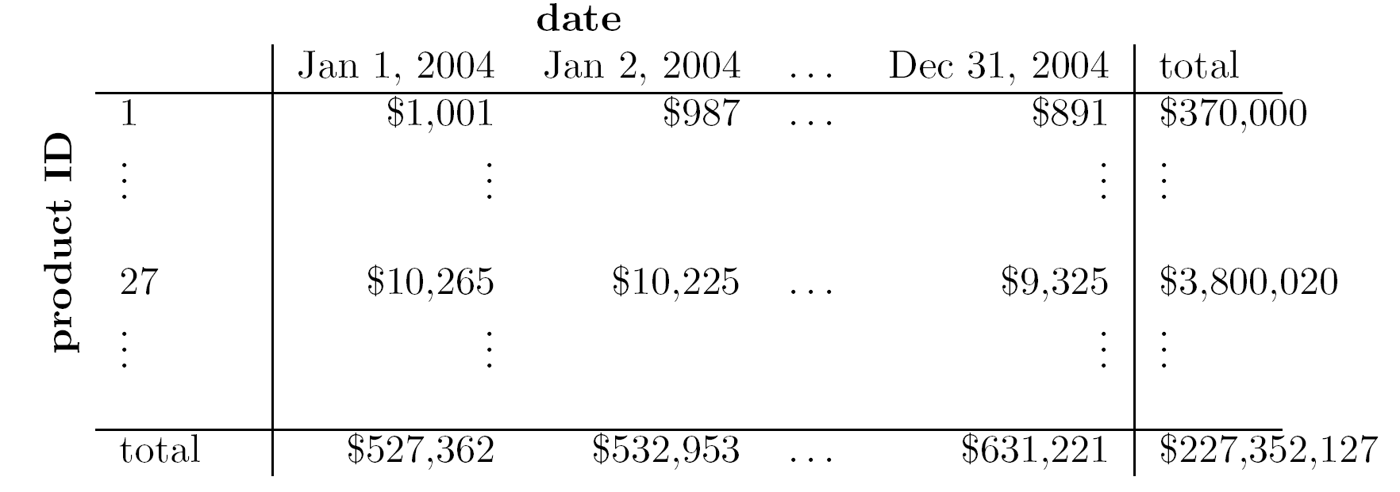
Data Cube Example (continued)
The following figure table shows one of the two dimensional aggregates, along with two of the one-dimensional aggregates, and the overall total

Slide 39
OLAP Operations: Slicing and Dicing
Slicing is selecting a group of cells from the entire multidimensional array by specifying a specific value for one or more dimensions.
Dicing involves selecting a subset of cells by specifying a range of attribute values.
  This is equivalent to defining a subarray from the complete array.
In practice, both operations can also be accompanied by aggregation over some dimensions.

Slide 40
OLAP Operations: Roll-up and Drill-down
Attribute values often have a hierarchical structure.
  Each date is associated with a year, month, and week.
  A location is associated with a continent, country, state (province, etc.), and city.
  Products can be divided into various categories, such as clothing, electronics, and furniture.
Note that these categories often nest and form a tree or lattice
  A year contains months which contains day
  A country contains a state which contains a city

Slide 41
OLAP Operations: Roll-up and Drill-down
This hierarchical structure gives rise to the roll-up and drill-down operations.
  For sales data, we can aggregate (roll up) the sales across all the dates in a month.
  Conversely, given a view of the data where the time dimension is broken into months, we could split the monthly sales totals (drill down) into daily sales totals.
  Likewise, we can drill down or roll up on the location or product ID attributes.

